Slide 1
Module 3
Building AI Agents with AutoGen

Slide 2
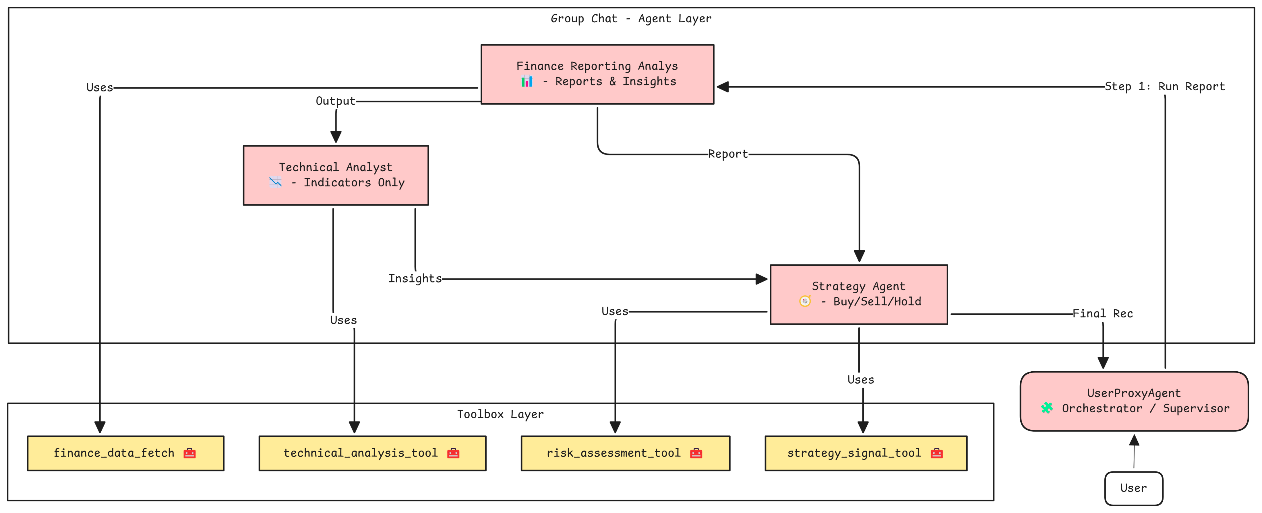
Agents and Tools for Financial Analysis

Slide 3
Agent 2 – Technical Analyst
Role: Perform technical analysis using predefined indicators
Responsibilities:
Analyze SMA, EMA, RSI, Last Close Price
Identify trends, patterns, and trading signals
Constraints:
No summaries or financial reports
Does not handle performance overview
No direct human input handling
Tool: technical_analysis_tool

Slide 4
Tool 2: technical_analysis_tool
Purpose: Perform basic technical indicator calculations
Metrics Extracted:
SMA (Simple Moving Avg) – 20-day
EMA (Exponential Moving Avg) – 20-day
RSI (Relative Strength Index) – 14-day
Last close price
Used by: technical_analyst to detect trends and momentum
Error Handling: Graceful fallback with error message in JSON
{
"name": "technical_analysis_tool",
"data": {
"SMA_20": 188.45,
"EMA_20": 190.21,
"RSI": 62.8,
"Last_Close": 192.32
}
}
Notes:
When to Plan Agent Roles:
Before coding orchestration logic
When multiple skills/tools are involved
When output requires sequential reasoning or aggregation
During architecture design of multi-agent systems

